Slide 1
Modernization Using GenAI

Slide 2
Team Members
Naveen Pakalapati
Subash Srinvasan
Page Tyler
Gopinath Durgaiyanaidu
Nithilaselvan Muthusamy
Sebastian Valenzuela

Slide 3
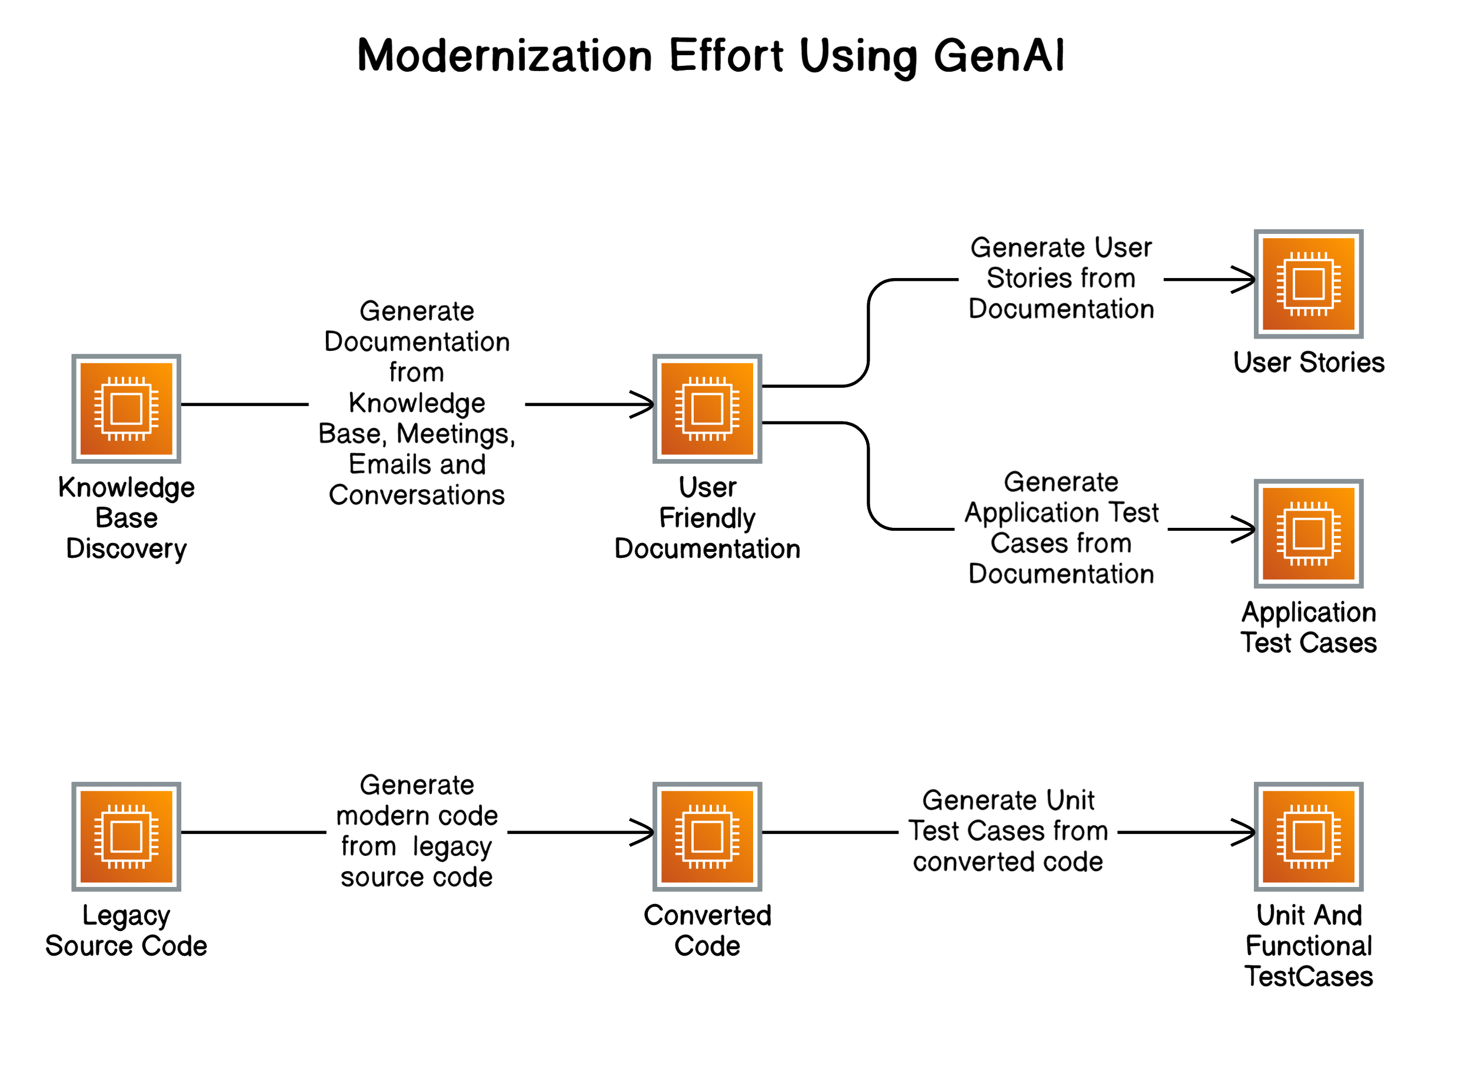
High Level Flow

Slide 4
Problem Statement

Slide 5
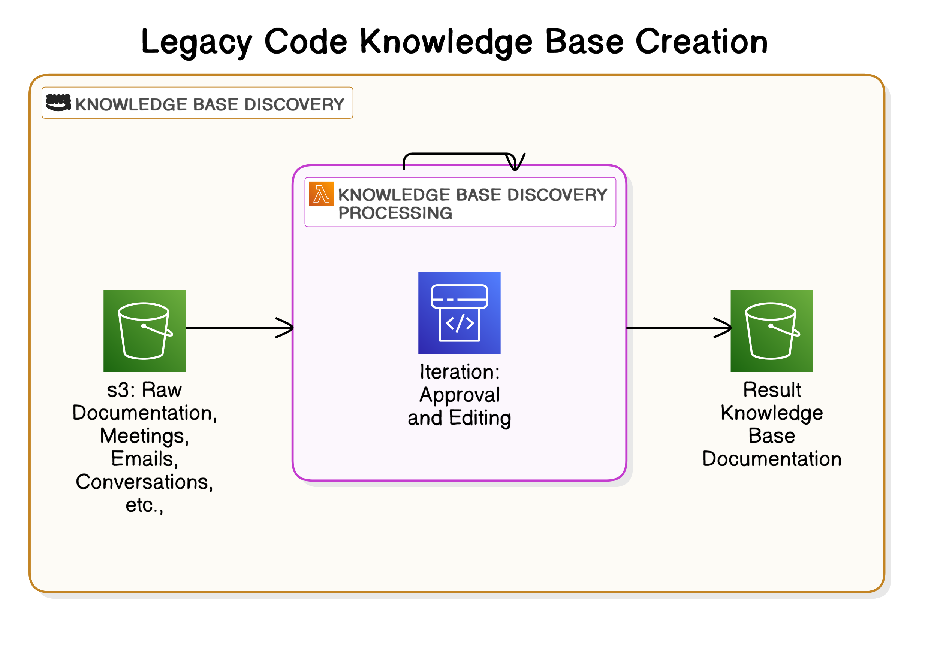
High Level Flow

Slide 6
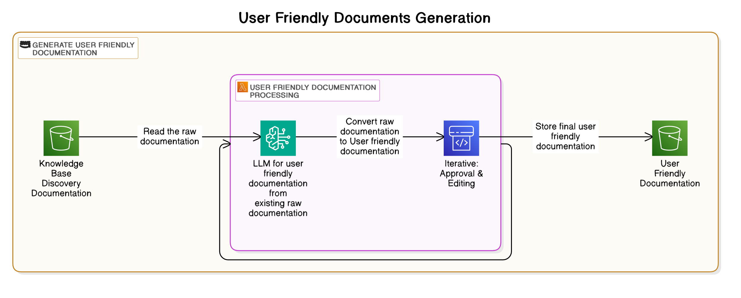
High Level Flow

Slide 7
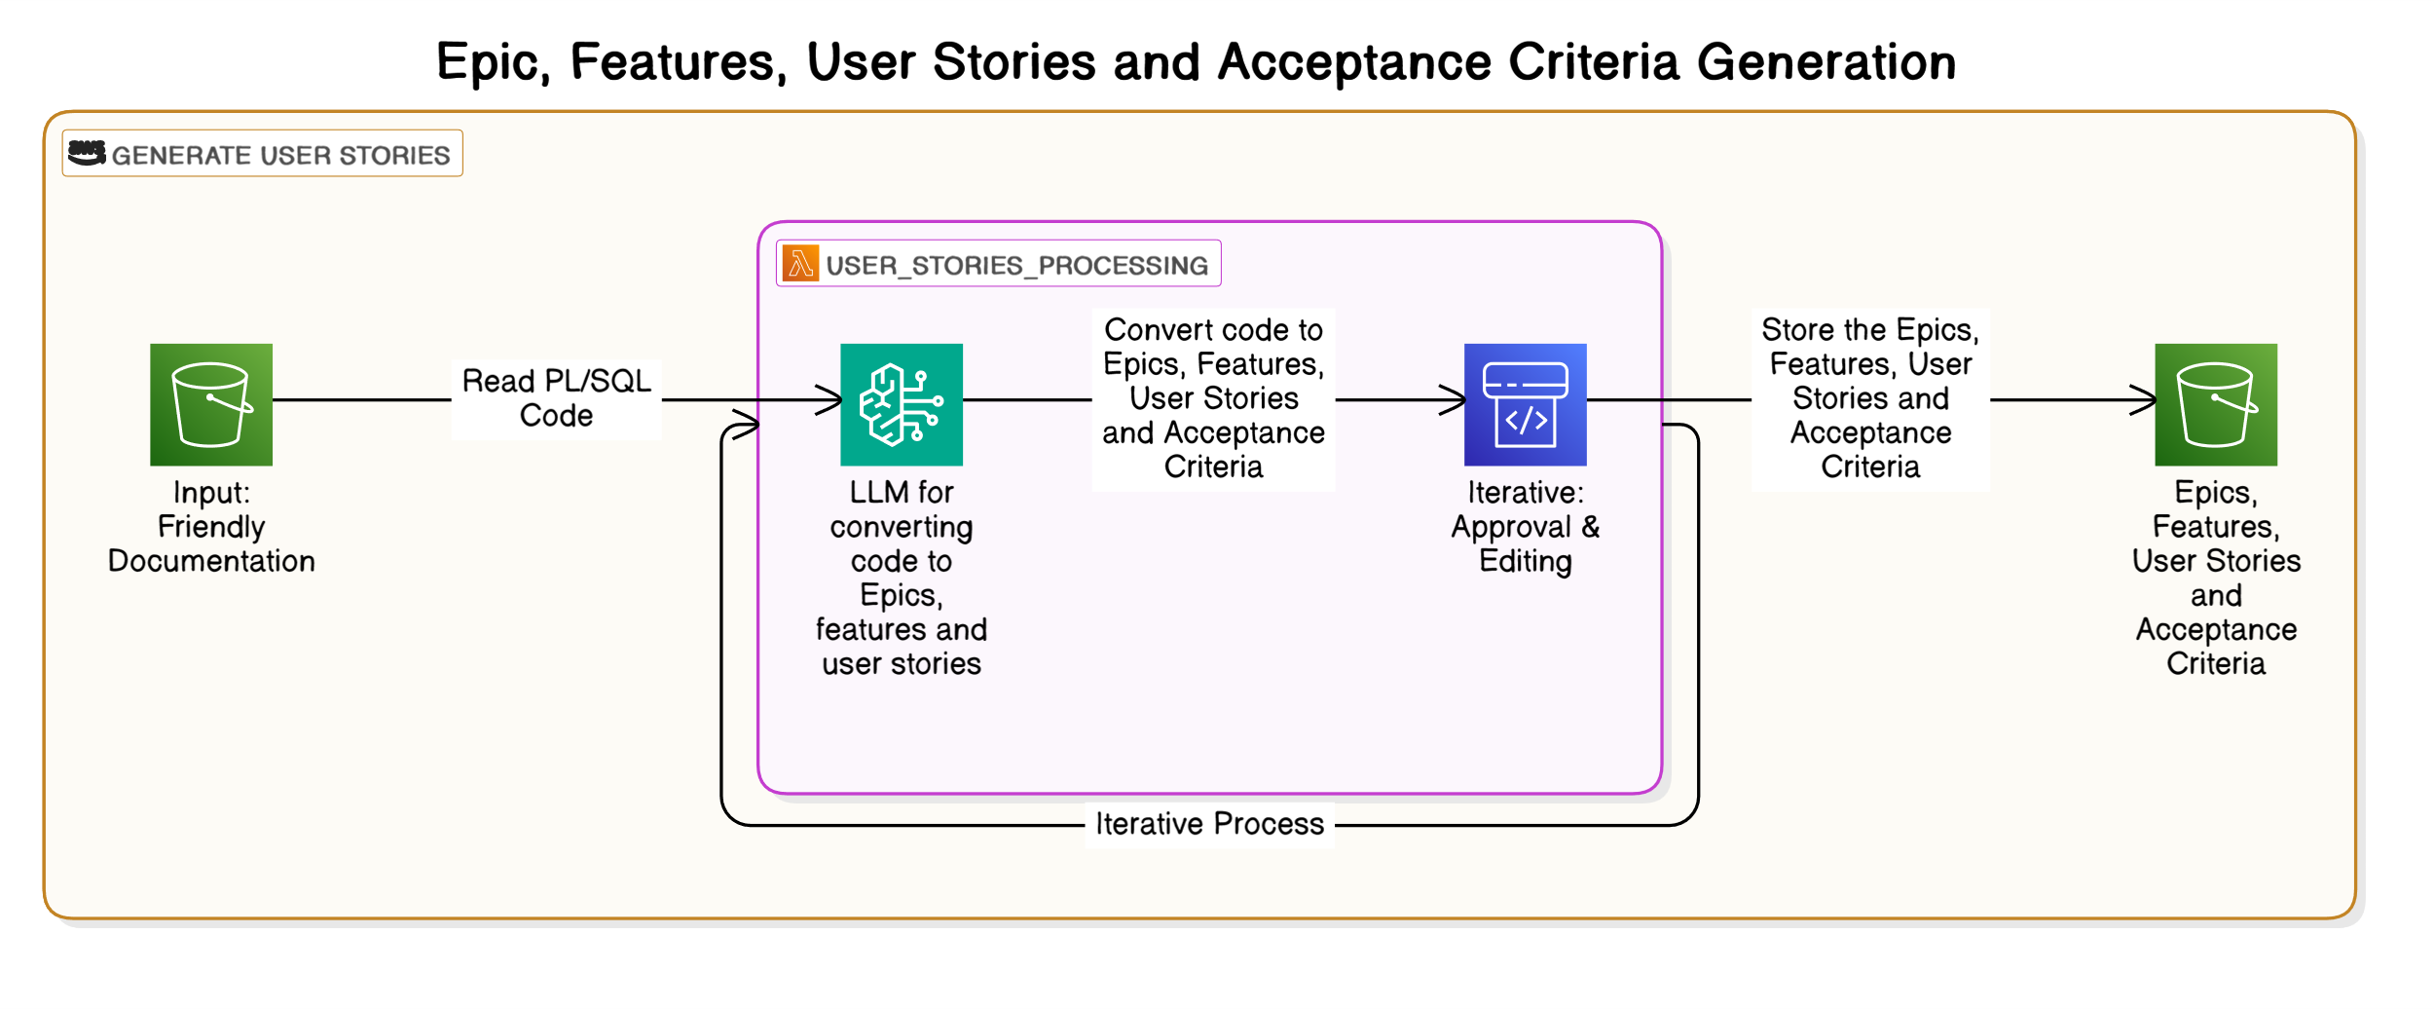
High Level Flow

Slide 8
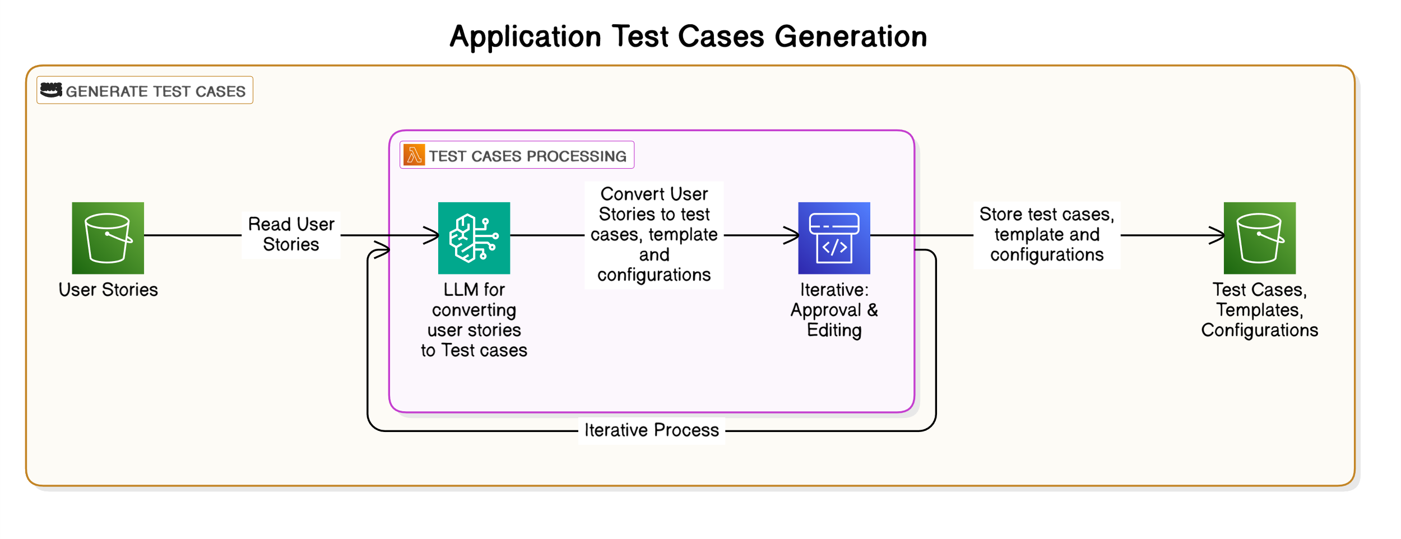
High Level Flow

Slide 9
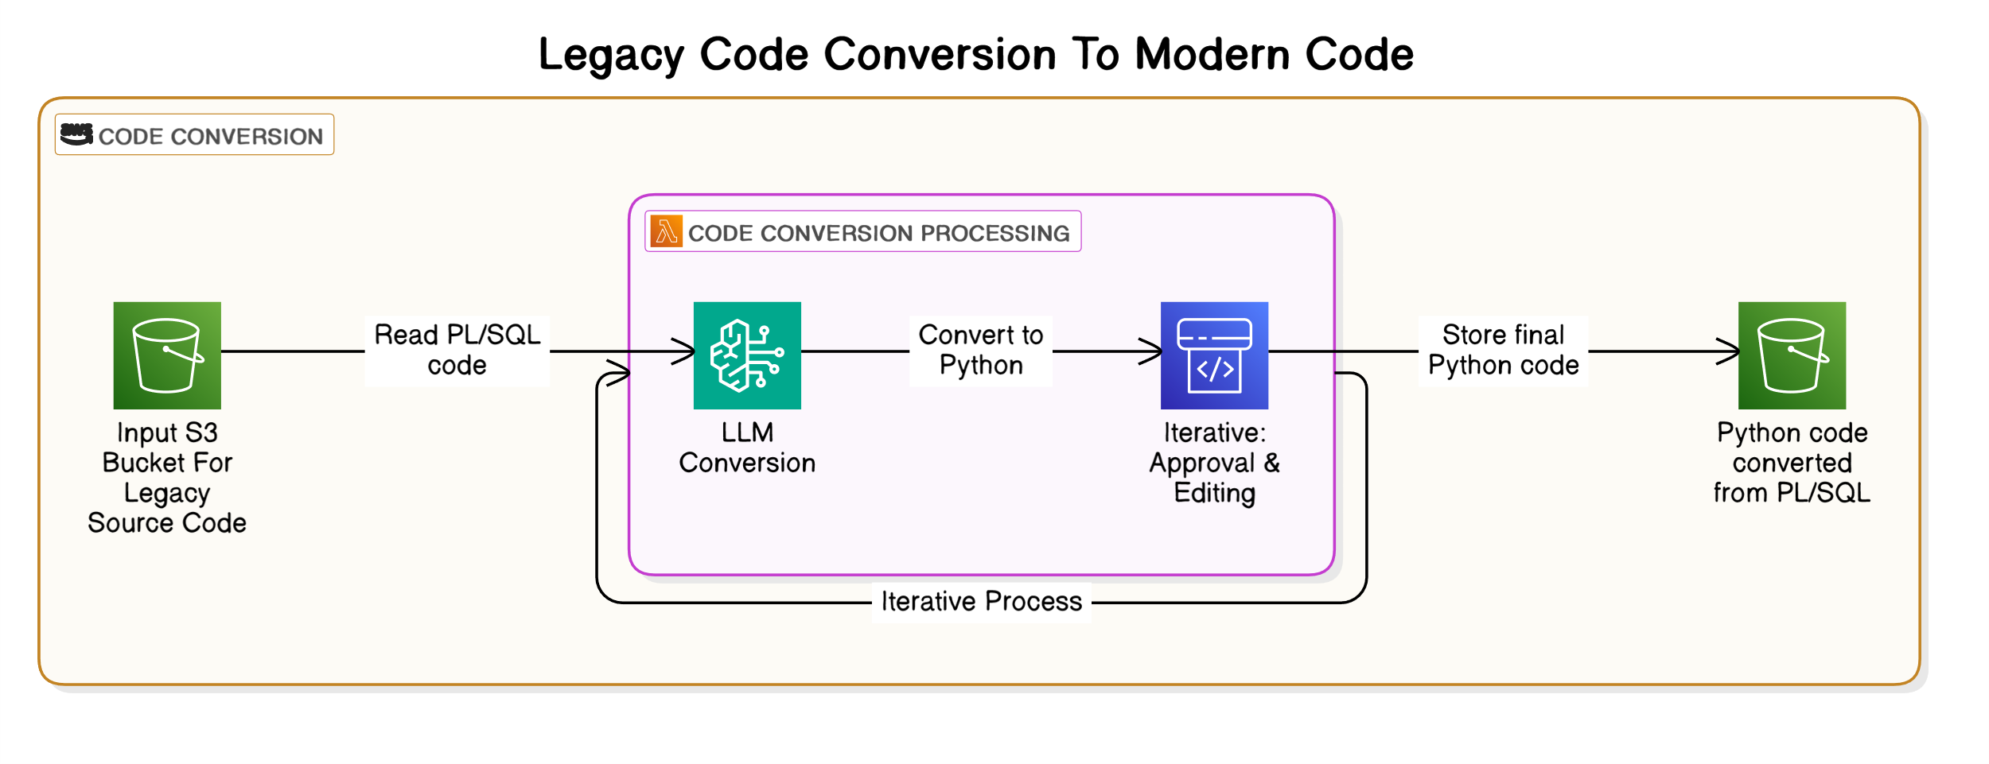
High Level Flow

Slide 10
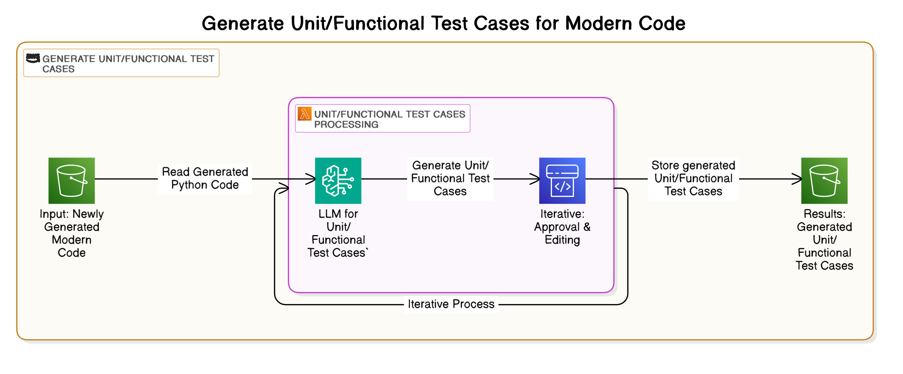
High Level Flow

Slide 11
High Level Flow

Slide 12
Bedrock usecase

Slide 13
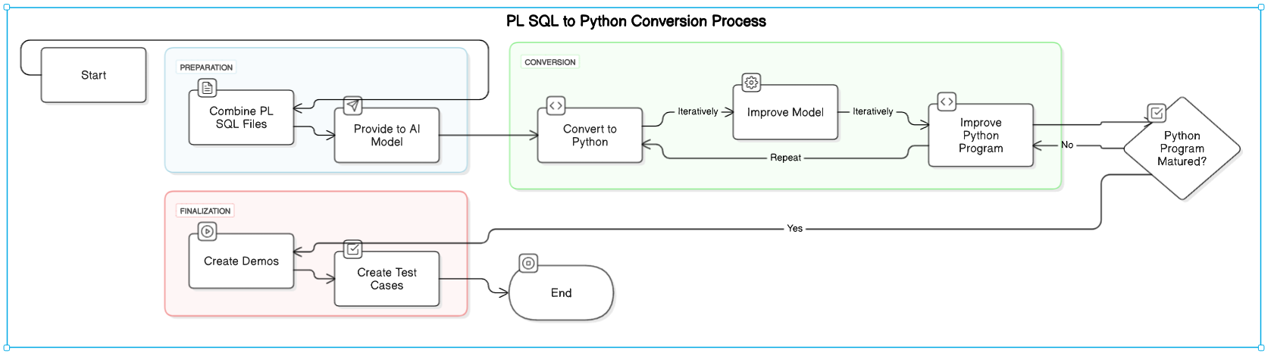
Alternate Model

Slide 14
Python Code Demo

Slide 15
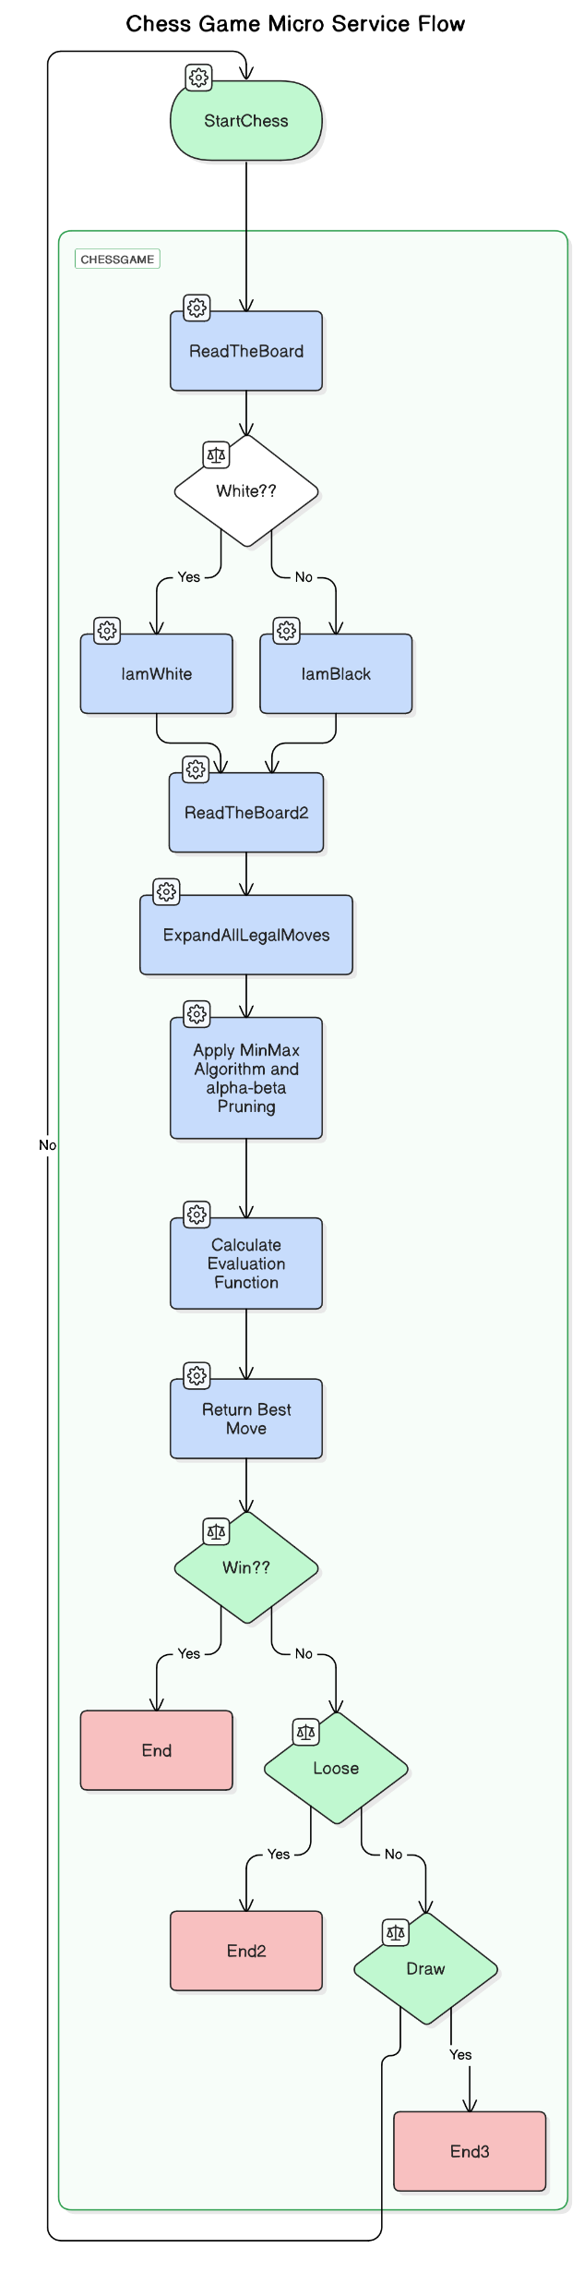
Micro Services Using Lamba, API Gateway, Step Functions

